Slide 1
Person Info
Annie Thomas Kanaparthi
Data Science August 25th Batch – UpX Academy

Slide 2
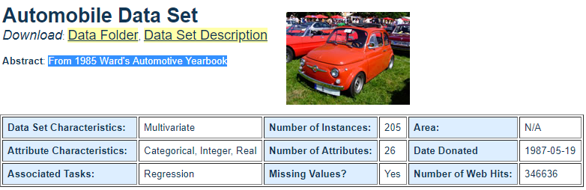
Domain and Topic of Project

Slide 3
Introduction
This project is part of Data Analytics with Python Module of Data Science Super Specialization Course
The Automobile Dataset contains information about a car’s manufacturer, Risk Factor, Vehicle specifications, Fuel Attributes, engine and price. This information is collected from 1985 Ward's Automotive Yearbook mainly for Analysis, Visualization and Study of different attributes of Automobiles during that period. The dataset can be found in UCI Machine Learning Repository.

Slide 4
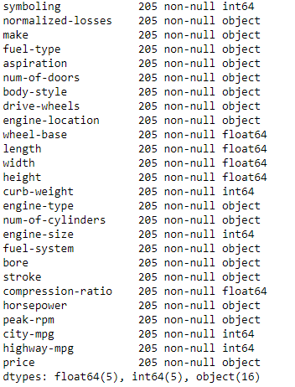
Dataset Description
Syntax: auto.info()

Slide 5
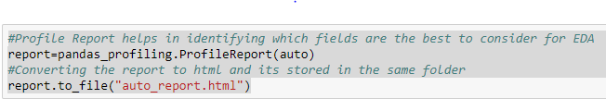
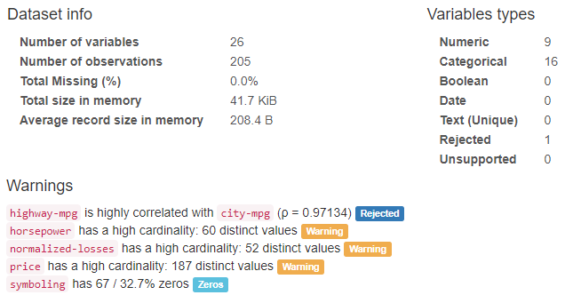
Profile Report of dataset
Syntax:
Overview of Dataset:

Slide 6

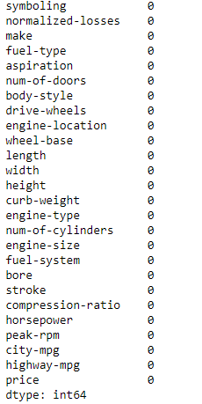
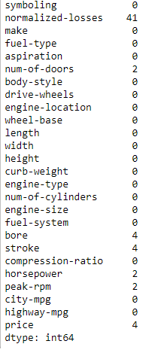
Evaluation of missing/junk data
Even though there are no null values , there are some fields which has value as '?' which is unacceptable

Slide 7
Data Pre-processing
Normalized-losses , num-of-doors , bore , stroke , horsepower, peak-rpm and price are the columns that have ? as values. Hence it has to be converted to readable values like mean/median /mode accordingly.
1.Normalized-losses → Replaced ‘?’ by mean
2.num-of-doors → Removed the rows with ‘?’(because each model has its own specifications and we cannot replace it based on mean/median/mode)
3.bore,stroke,horsepower and peak-rpm → Replaced ‘?’ with mode
4.price → Replaced ‘?’ with mean price
The Columns that were having numeric values and with datatype object are changed to integer or float accordingly.

Slide 8
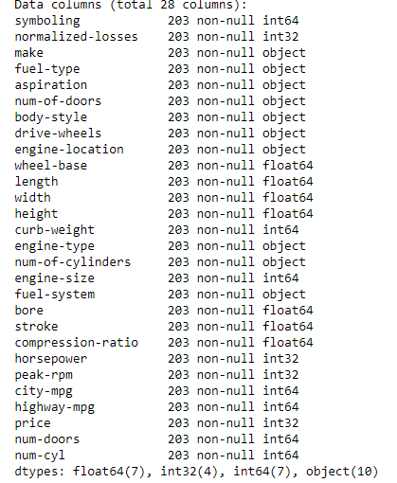
Final Dataset after pre-processing
The cleaned dataset is written into a new csv file

Slide 9
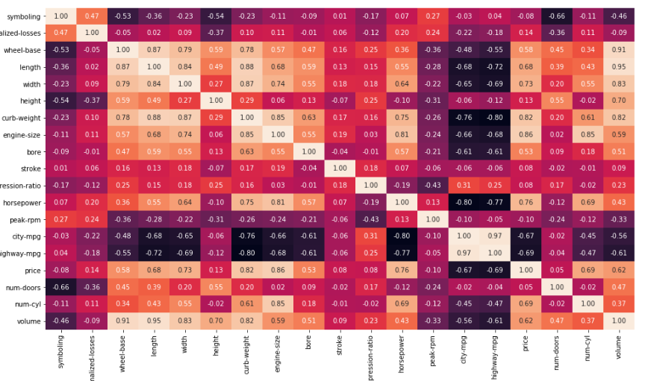

Correlation Analysis-By Heat map
From the heat map, we can see that:
a) the price is positively correlated to wheel-base, length, width, curb-weight , engine-size, horsepower and number of cylinders
b) symbolling is negatively correlated to most of the attributes except for normalized-losses
c)All the physical attributes of a vehicle should be positively correlated, and the map really says it so by the way the following attributes like wheel-base, length, width, curb-weight , engine-size are distributed.
d)highway-mpg and city-mpg are highly correlated.
e)Also, the engine-size and horse-power are also correlated in a positive way.

Slide 10

Business Questions
Automobile Dataset

Slide 11
The business questions are generally classified into these main areas:
Make(Manufacturer) Analysis
Risk Analysis
Price Analysis
Vehicle Specification
Fuel Attribute Analysis
Engine Attributes
Mileage

Slide 12
Make/Manufacturer Analysis - based on make
Automobile Dataset

Slide 13
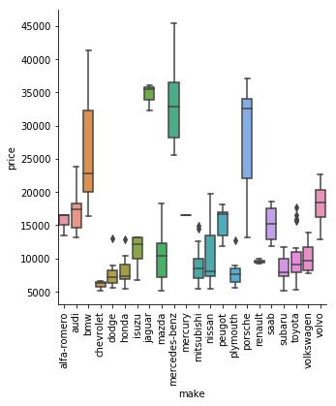

Which is the most expensive and cheapest car in the dataset?
Expensive car - Mercedes-Benz with a price of $45400
Cheapest car - Subaru with a price of $5118

Slide 14
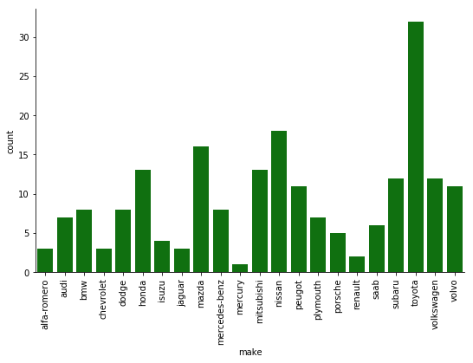
Highest – Toyota Lowest - Mercury
Which manufacturer has the highest /lowest number of models?

Slide 15
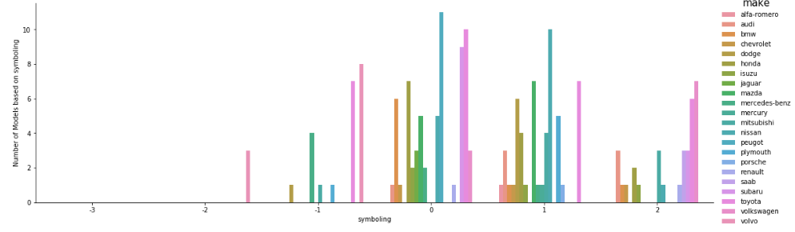
Picture Analysis of Manufacturers based on Symbolling
Positive value for symbolling means the riskier the vehicle is. Depending on the plot we can say that most of the manufacturers make automobiles that are risky where most of the vehicles lies at the neutral symbolling point which is 0.

Slide 16
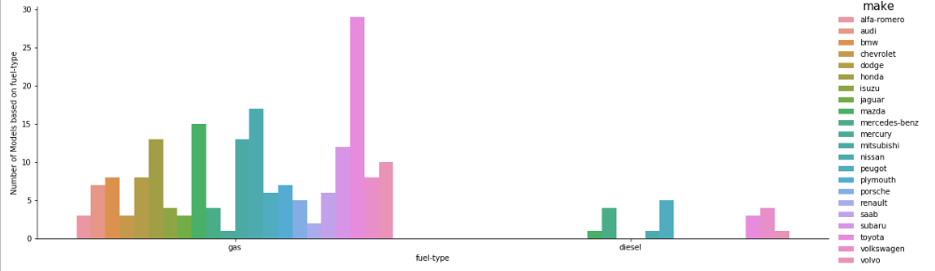

Picture Analysis of Manufacturers based on Fuel-type
Most of the manufacturers make automobiles with fuel-type gas and very few manufacturers use the diesel type.

Slide 17
Risk Analysis - based on normalized losses and symbolling attributes
Automobile Dataset

Slide 18
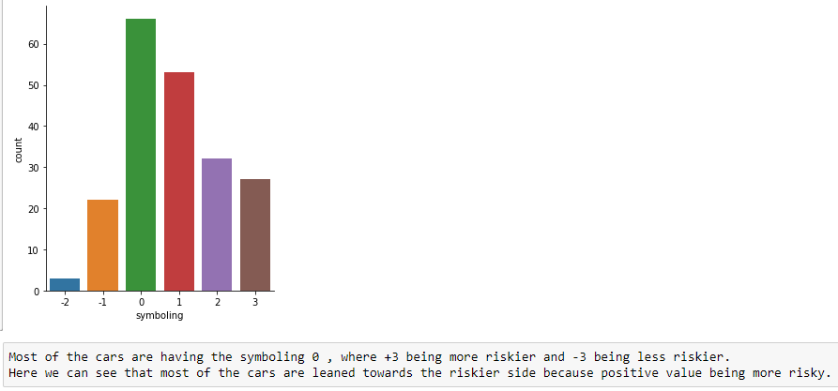
Importance of symbolling in Dataset

Slide 19
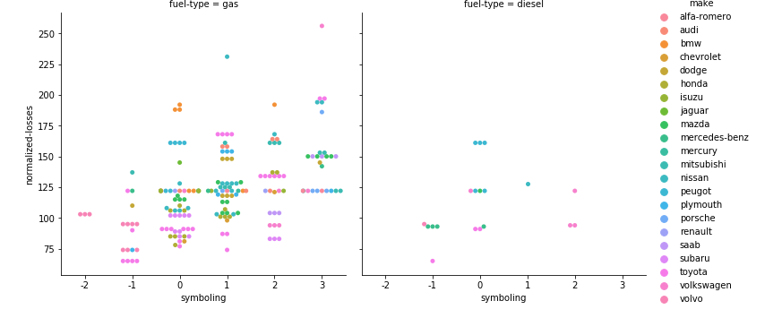
Risk analysis based on fuel-type and manufacturer
The normalized-losses (average loss payment per insured vehicle) is more for the vehicles that have symbolling greater than zero. As risk increases , the normalized losses also increases.

Slide 20
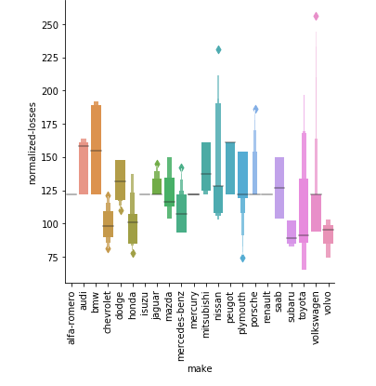
Risk analysis based on manufacturer
From the plot , its clear that the normalized-losses (average loss payment per insured vehicle) is more for Volkswagen and its least for Toyota.

Slide 21
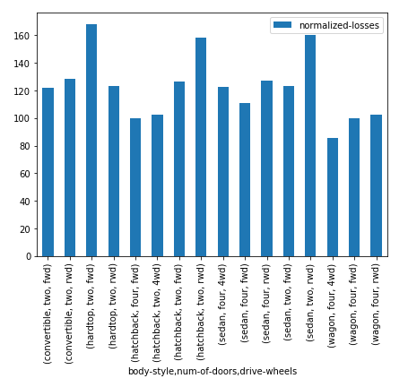
Risk analysis based on body-style ,drive-wheels and number of doors
Here , we can see that the normalized losses(relative average loss payment per insured vehicle year) is
high for two-doors vehicles than four-doors vehicle but its distributed across different body style and drive-wheels type.
Also we can see that normalized-losses is comparatively more for rwd(rear-wheel drive) which makes sense as rwd is found often
in sports cars, performance sedans, big trucks, race cars, and law enforcement pursuit vehicles.

Slide 22
Price Analysis - based on price
Automobile Dataset

Slide 23
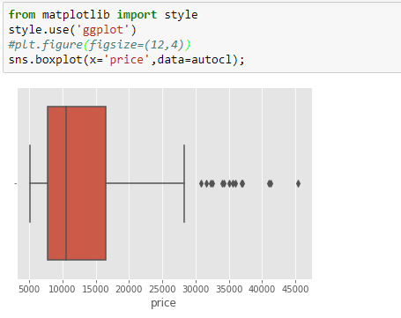
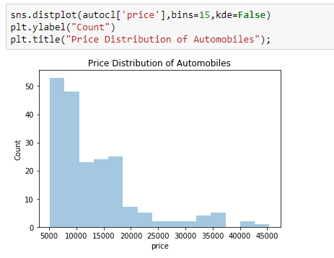
Price Distribution of automobiles in the dataset
The distribution plot based on price shows that this dataset contains high number of less expensive cars and more cars are in the range $5000 to $28000.

Slide 24
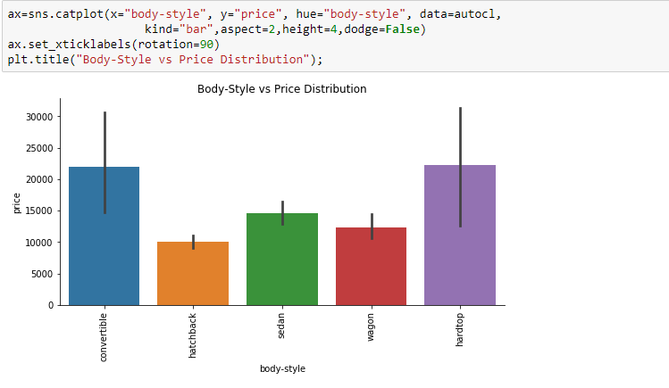
Price Distribution of automobiles based on body-style
The Body-style is one of the main aspect in deciding the price as we can see that convertible and hardtop styles are expensive
than hatchback, sedan and wagon because they comes under the cap of luxurious cars.

Slide 25
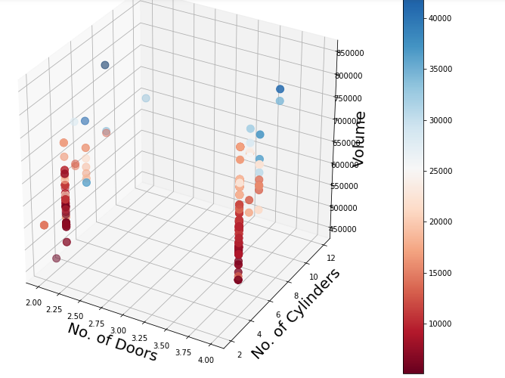
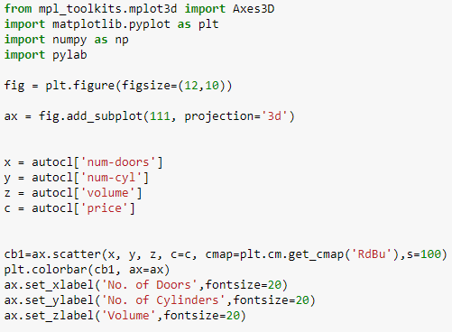
3D plot representation based on number of doors & cylinders and volume of vehicle
Price increases according to the volume and the number of cylinders regardless of the number of doors. More the number of cylinders, more the volume , then more the price too.

Slide 26
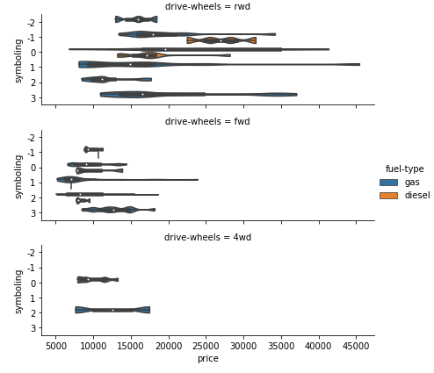
Price based on symbolling , fuel-type and drive-wheels
Most of the rear-wheel drive cars are distributed across all the symbolling values and has both fuel-type vehicles too which we can see as the expensive cars in the dataset.
Forward-wheel drive cars are less compared to rear-wheel drive cards and also have most of them with positive symbolling value but with less price.
Very less cars have 4-wheel drive with good symbolling value and less price.

Slide 27
Vehicle Specification - based on vehicle attributes in dataset
Automobile Dataset

Slide 28
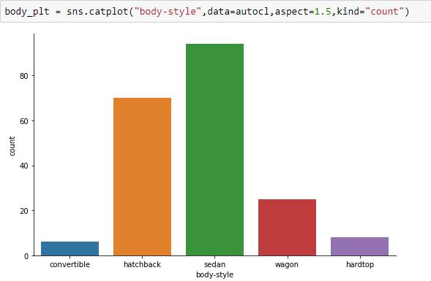
Body-style distribution in dataset

Slide 29
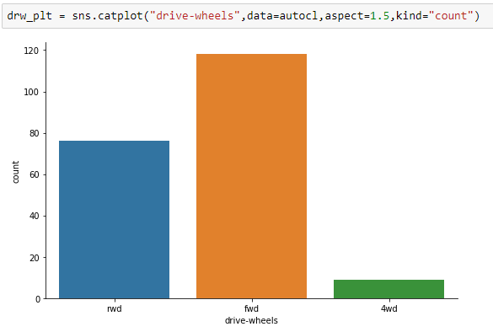
Drive-wheels distribution in dataset

Slide 30
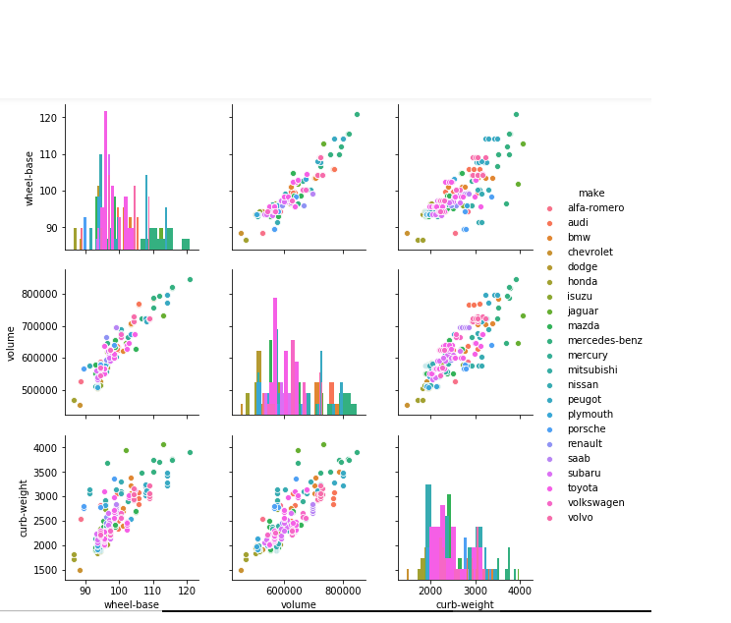
Pair plot of vehicle attributes
Wheel-base , volume and curb-weight are positively correlated.
Wheel base increases for bigger vehicles and they also will be heavy.

Slide 31
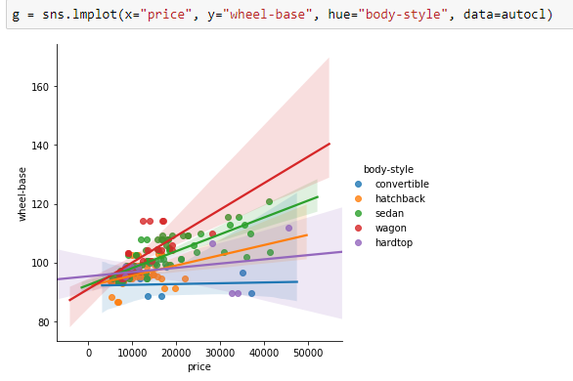
Linear model plot of vehicle attributes and price
Depending on wheel-base and body-style , the price of a vehicle increases. They are positively correlated.

Slide 32
Fuel Attribute Analysis - based on fuel-system, fuel-type
Automobile Dataset

Slide 33
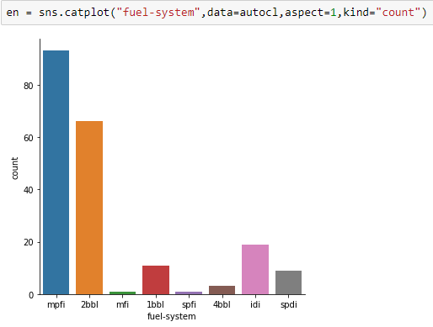
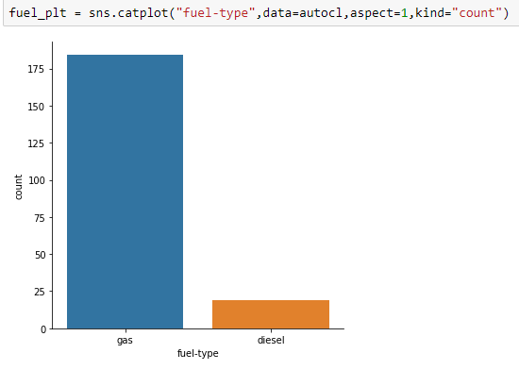
Distribution of fuel attributes

Slide 34
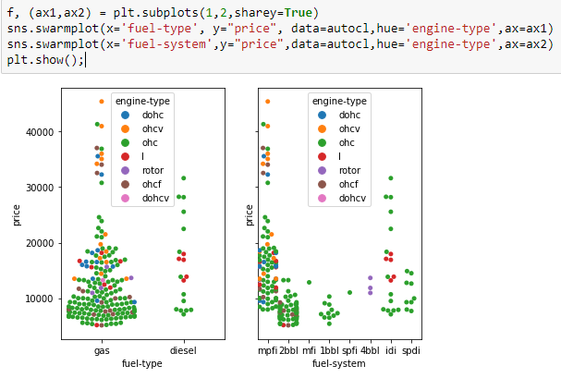
Distribution of fuel attributes
From the plot , we can see that the more common fuel-type is gas and common fuel-systems are mpfi and 2bbl with a common engine type of ohc on less costly cars.
Whereas , there are expensive cars also with these attributes.

Slide 35
Engine Attribute Analysis
Automobile Dataset

Slide 36
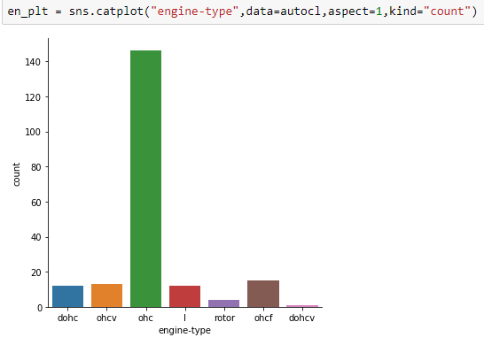
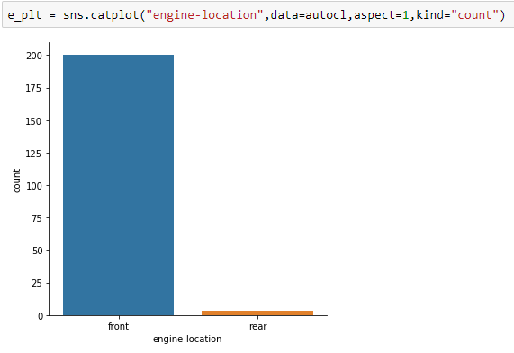
Distribution of engine attributes

Slide 37
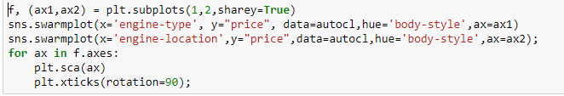
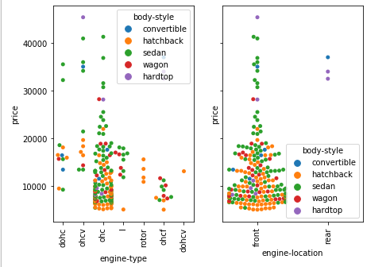
Distribution of engine attributes based on price and body-style
We can see that sedan and hatchback automobiles are distributed among each type of engines with engine location in the front . These cars are also not so expensive.
Very few cars that are hardtop and convertible have the engine in the rear which are also expensive.

Slide 38
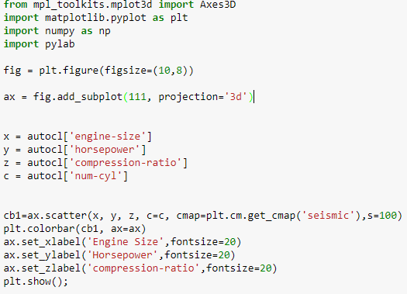
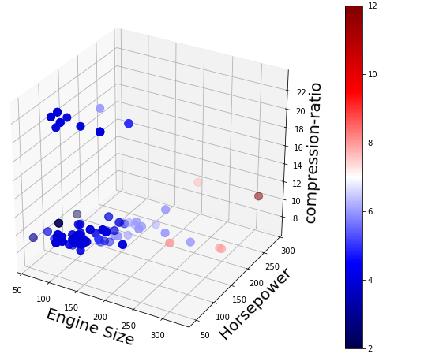
3D plot based on engine size, horsepower, compression-ratio and no. of cylinders

Slide 39
Mileage Analysis
Automobile Dataset

Slide 40
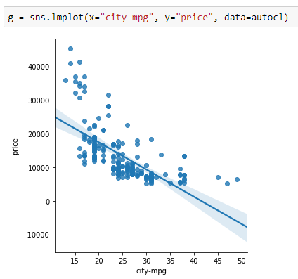
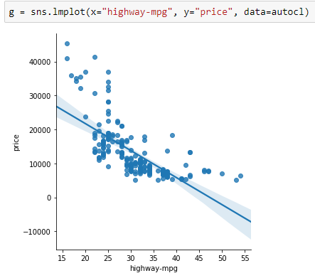
Distribution of city-mpg ,highway-mpg and price
City mpg(Miles per gallon) determines the fuel efficiency of a vehicle while running in City. This is negatively correlated to price which means fuel efficient cars mostly comes in the low budget bracket mainly for daily use. Also, city-mpg and highway-mpg are highly correlated.

Slide 41
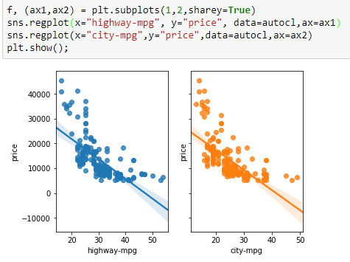
Distribution of city-mpg , highway-mpg and price

Slide 42
Thank You

